Slide 1


CISB5133
Sentiment Analysis &
Topic Modeling
Jabal Omar Marriott Hotel Reviews
ALSAKKAF MUSAAB (SW01083207)
BAWZIR AHMED ALI AHMED (SW01084040)
ALHATHAL NAIF MASHAAN D (SW01084553)
HASHEM MUSAAB (SW01084071)
MOUSAB MOHAMMED ELHASSAN ADAM (SW01084034)
ZRIYAB ABUBAKER MOSTAFA (SW01082419)

Slide 2

Jabal Omar Marriott Makkah
PROBLEM STATEMENT
Online hotel platforms contain hundreds of customer reviews.
It is difficult to manually analyze all reviews to understand customer satisfaction.
Important insights about service, cleanliness, and facilities may be missed.

Slide 3

Jabal Omar Marriott, Makkah
OBJECTIVE
• Analyze guest reviews from Tripadvisor
• Identify overall customer sentiment
• Discover common topics (service, cleanliness, location)
• Extract meaningful insights from text data

Slide 4

Jabal Omar Marriott, Makkah
DATASET
Source: Tripadvisor
Hotel: Jabal Omar Marriott, Makkah
Total reviews: 497
Language: English
Collected using Python (Selenium)
Stored in CSV format

Slide 5

Sentiment Analysis
PREPROCESSING
Convert text to lowercase
Remove punctuation, numbers, and URLs
Remove stopwords
Apply lemmatization
Perform tokenization

Slide 6

Jabal Omar Marriott, Makkah
SENTIMENT ANALYSIS
Method: VADER Sentiment Analysis
Suitable for short review texts
Classifies reviews into:
• Positive
• Negative
• Neutral
• Uses compound score for sentiment polarity

Slide 7
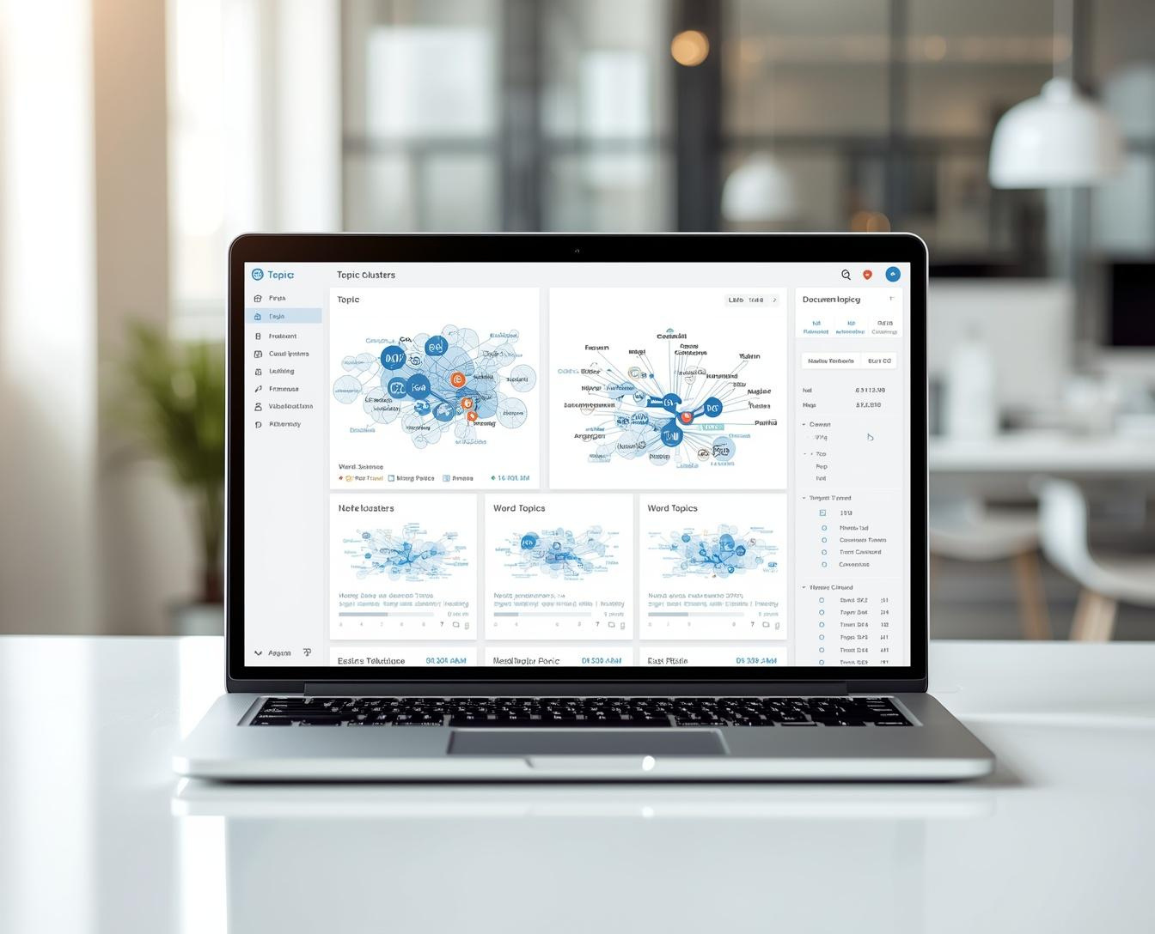
CISB5133
TOPIC MODELING (LDA)
Method used: Latent Dirichlet Allocation (LDA)
Used to identify hidden topics in reviews
Helps understand key themes in customer feedback
Topics include areas such as service, location, and facilities
Number of topics: 4 Topic

Slide 8

Musab | CISB5133
EVALUATION
Evaluation metrics: Coherence Score (Notebook) & Perplexity (Dashboard)
Used to evaluate topic quality
Results indicate meaningful topic grouping

Slide 9
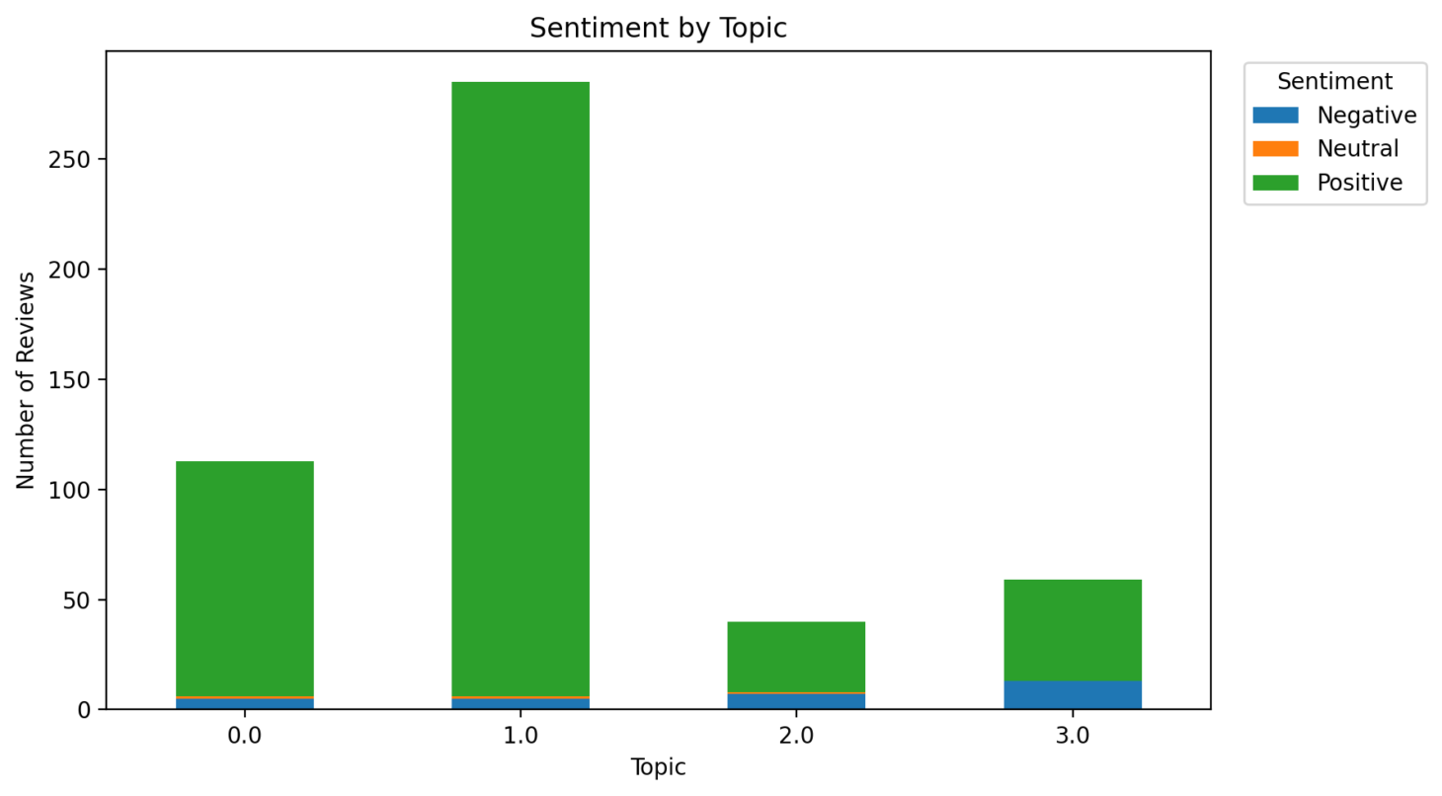
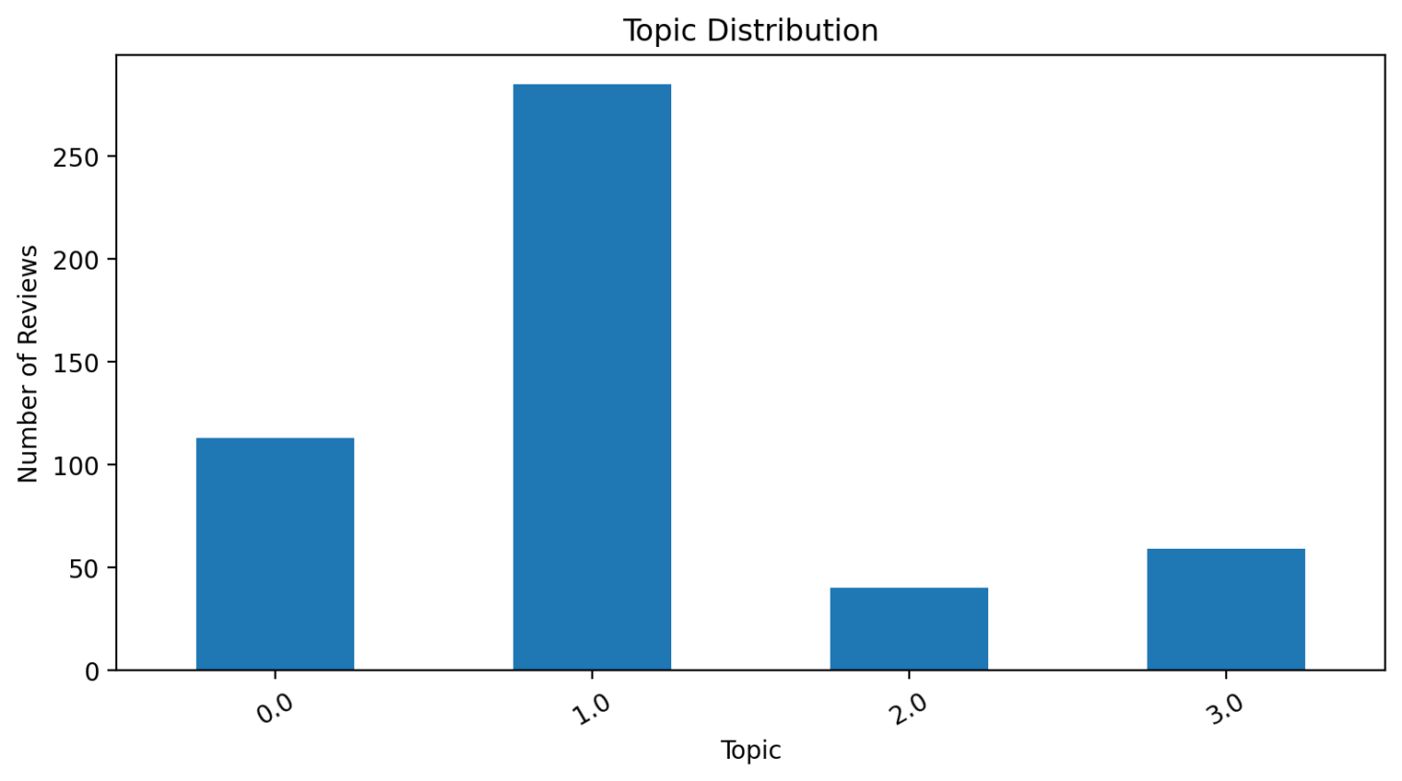
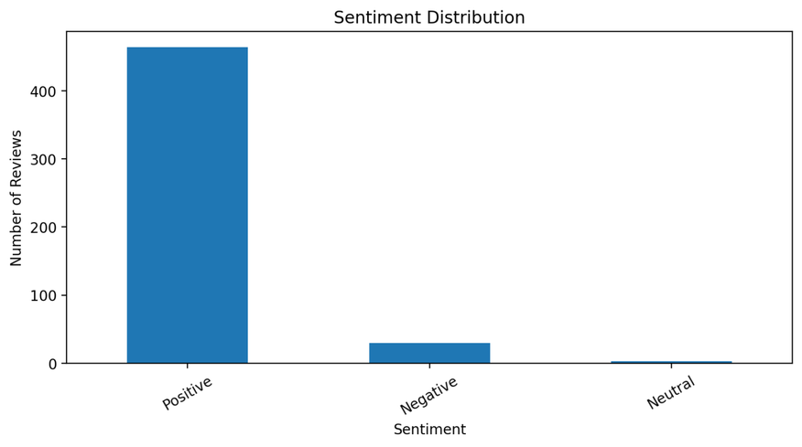
CISB5133
VISUALIZATION
Sentiment distribution chart
Topic distribution
Word cloud visualization
Sentiment vs Topic analysis

Slide 10
Jabal Omar Marriott
KEY INSIGHTS
The dominant sentiment is positive, representing the majority of reviews
The most frequent topic appears consistently across reviews
Negative feedback is concentrated in specific topics
Repeated keywords highlight common customer concerns and experiences

Slide 11
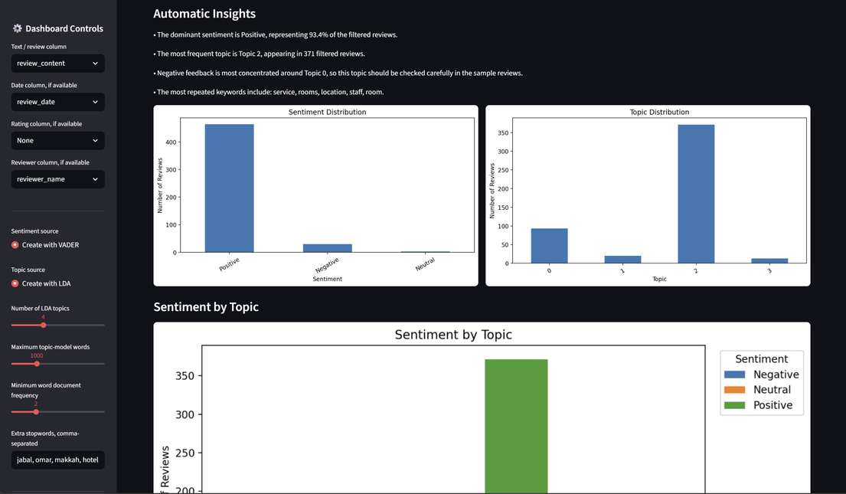
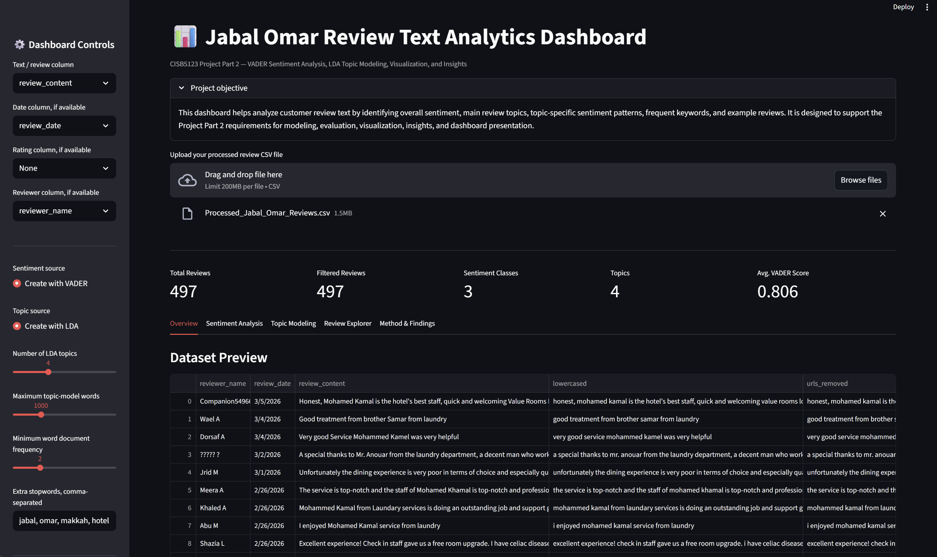
CISB5133
DASHBOARD
Interactive dashboard developed using Streamlit
Allows filtering by sentiment and topic
Displays dynamic insights based on selected data
Includes:
Sentiment distribution
Topic modeling
Word frequency & word cloud
Review explorer

Slide 12

CISB5133
Conclusion
Text analytics helped extract useful insights from customer reviews
Sentiment analysis showed overall positive customer satisfaction Topic modeling identified key themes such as service, location, and facilities
The dashboard provides an interactive way to explore the data
Future improvements:
JABAL OMAR MARRIOTT HOTEL, MAKKAH
Use advanced models (e.g., BERT)
Include more data sources
THANK YOU FOR YOUR ATTENTION

